Slide 1
Security in CAN Bus

Slide 2
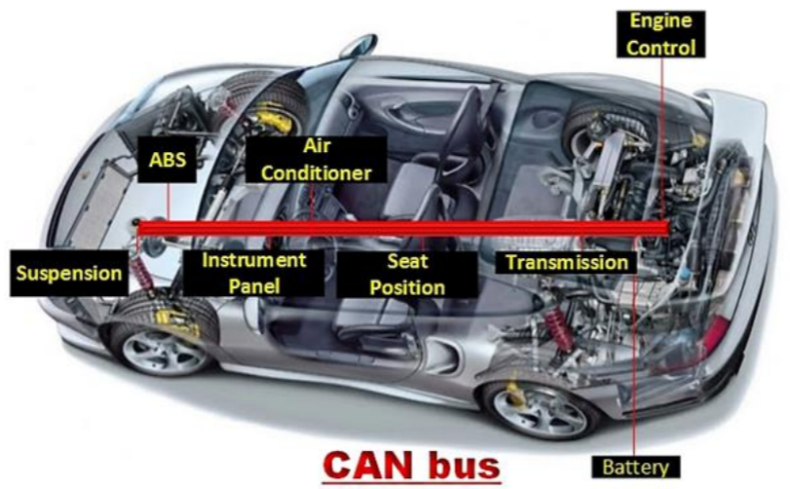

Slide 3
Problem Statement
The project is based on attacking , prevention and detection of CAN Bus.
Lack of security in the protocol of one of the most upcoming technologies - automated cars - motivated us to undertake this project.
Developing an authentication scheme and encryption that would add a logical layer of security over the protocol without affecting the timeliness of the messages would be our ultimate goal.
We also have dwelled into machine learning and data mining by detecting intrusion using models such as LSTM, DNN, Entropy and Apriori
These models predicted anomalies in the CAN Bus data stream.

Slide 4
What is CAN Bus ?
A vehicle bus to allow microcontrollers and devices to communicate directly with each other.
Designed for multiplex electrical wiring within automobiles.
CAN network used in many everyday products.
It replaces the traditional architecture of wiring with a new architecture consisting of only one bus, the CAN bus.

Slide 5
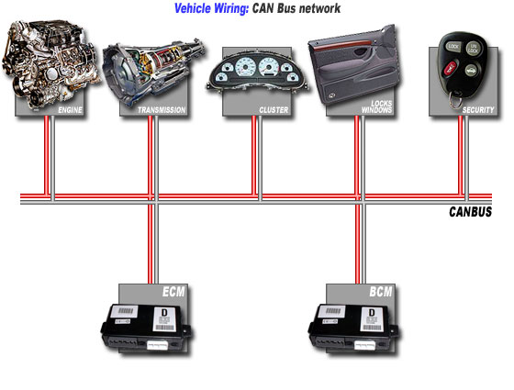
How it works using CAN Bus

Slide 6
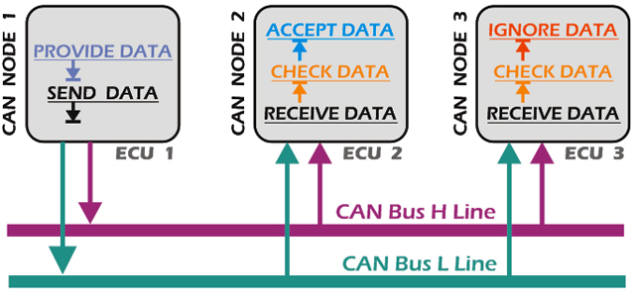
A Brief Overview of Working of CAN

Slide 7




Data Frames : Format
Standard Format ( CAN 2.0A ): 11-bit identifier
Bus Idle Arbitration Field
Control Data Field CRC Field
Field
Ack End of Inter-
Bus Idle
Field Frame
frame Space
Field
recessive
S
R I r
D A D
Bus Idle
^{O} 11-bit Identifier ^{T D 0} DLC
0..64 Bit Data
15-bit CRC
^{E C E} 7-bit EOF IFS
Bus Idle
dominant
F
R E
L K L
Extended Format ( CAN 2.0B ): 29-bit identifier
Bus Idle
Arbitration field
Control Field
Data Field
CRC Field
Ack End of
Inter- Bus Idle
Field Frame
frame Space
Field
recessive
S
S I
R r r
D A D
Bus Idle
^{O} 11-bit Base Id
^{R D} 18-bit Ext. Id ^{T 1 0} DLC 0..64 Bit Data 15-bit CRC ^{E C E} 7-bit EOF IFS Bus Idle
dominant
F
R E
R
L K L

Slide 8
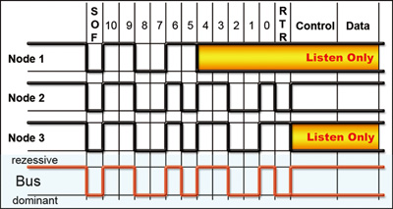
Working of Arbitration in CAN

Slide 9
How to Exploit CAN BUS ?
Level 1: Prevent ECUs from being compromised
Level 2: Protect the vehicle’s internal network against a compromised ECU
Level 3: Detect the compromise of an ECU

Slide 10
Why is it easy to Exploit CAN Bus ?
A CAN frame has no authentication field.
There is no authentication performed on the sender and receiver of a particular frame.
The data field size in a CAN frame is only 8 bytes long, making it difficult to add large-key security measures.
ECUs do not always have the computational power necessary to perform cryptographic functions.
Besides, CAN is NOT poorly designed.

Slide 11
Types of Attacks
Denial of Service (DoS)
Replay Attack
Injection/Diagnostics Attack

Slide 12
Encryption using AES
A replacement for DES was needed as its key size was too small.
With increasing computing power, it was considered vulnerable against exhaustive key search attack.
The features of AES are as follows −
Symmetric key symmetric block cipher
128-bit data, 128/192/256-bit keys
Stronger and faster than Triple-DES
Provide full specification and design details
Software implementable in C and Java

Slide 13
Working
A packet in CAN bus consists of 8 bytes ie 64 bits whereas AES uses 128 bit blocks for encryption and decryption.
Hence 8 bytes of 0s are padded to the original packet
A key, which is shared between the sender and receiver, is used for both encryption and decryption.
The encrypted data is presented as 128 bits which are then sent as two packets to the receiver.

Slide 14
At the receiver end, the encrypted packet is decrypted using the shared key.
The right most 8 bytes are discarded (which is the padding) and the remaining 8 bytes represent the original data.
Our analysis of the timing constraints due to AES show that encryption needs a time penalty of 1000 µs whereas the entire time duration of sending and receiving packet without any security is 12000 µs.

Slide 15
Advantages of using AES
Till date, no practical cryptanalytic attacks against AES has been discovered.
Additionally, AES has built-in flexibility of key length, which allows a degree of ‘future-proofing’ against progress in the ability to perform exhaustive key searches.
AES is one of the fastest encryption techniques in both hardware and software, which needs to be the most important criteria for CAN bus.

Slide 16
Authentication Scheme
Authentication through Random Keys
One Master Controller
Every authorized device will have a variable named ‘nonce’
nonce acts as a shared key
Assumption:
During initialization only authorized devices are connected

Slide 17
Working
The master node broadcasts a setup data frame containing a randomly generated nonce.
This nonce is received and stored by all the devices connected to the CAN bus.
The sending device will create an HMAC of the data along with the nonce as the key.
This HMAC would be attached to the data frame and broadcasted onto the CAN bus.
The receiving device will authenticate the data in the same way.
If the data frame is verified, the command is executed.

Slide 18
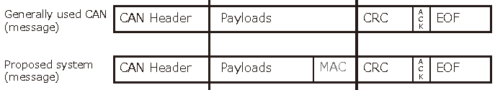
Random Key ‘nonce’
The nonce in a controller increases by 1 whenever an authenticated message is received.
As the architecture of CAN bus uses a broadcasting technique, the nonce of all the authorized devices remains synchronized.

Slide 19
Advantages of using HMAC
Due to the use of HMAC, concrete authentication technique can be implemented.
As the HMAC is structured to create a small-sized output, the latency might not be much.
The use of varying nonce, replay attack can be prevented as replay of frames would result in a mismatch of hashed nonce.
HMAC can make use of current hash functions without making any modifications.

Slide 20
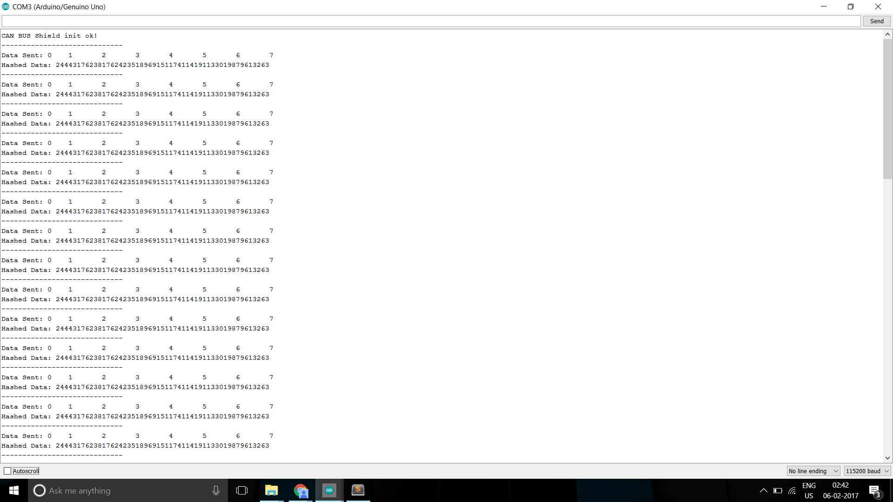
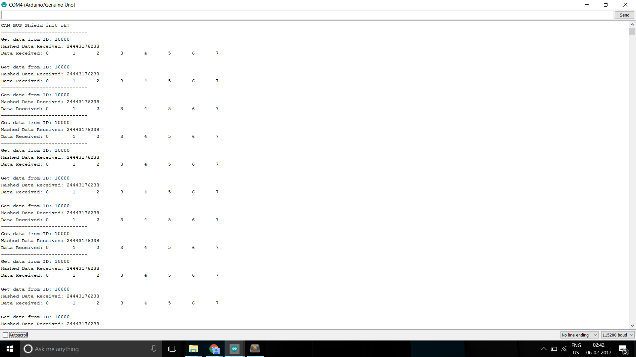
Hashing at Sender Authentication at Receiver

Slide 21
An optimized HMAC Scheme - H²MAC
This optimised MAC is almost the same as HMAC except that the second call to the secret key, which is made at the finalization stage, is omitted.
In this way we not only increase efficiency over HMAC but also reduce the cost of managing the key, as the new MAC invokes a key only once at the initialization stage, and the rest of the process depends solely on incoming data.
The H² -MAC algorithm is very simple to define: Given a Merkle-Damgard hash function
H : { 0, 1}∗ → { 0, 1}^{n} and a secret key K ∈ { 0, 1}^{n} , the tag T for a message M ∈ { 0, 1}∗ is computed as:
T = H ( H ( K || pad || M ) ) = H² ( K || pad || M ),

Slide 22
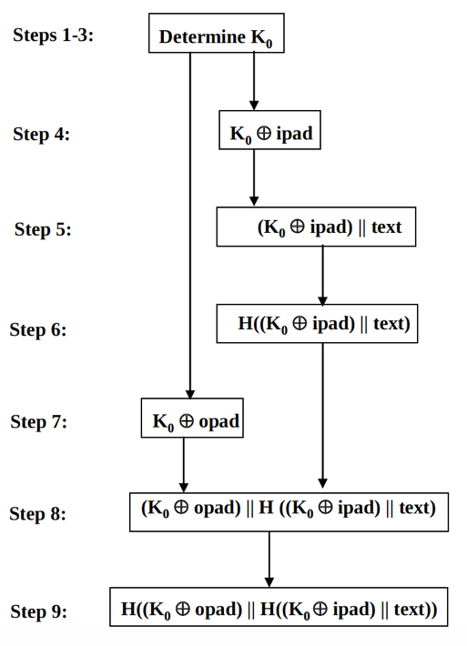
Working of the H²MAC scheme

Slide 23
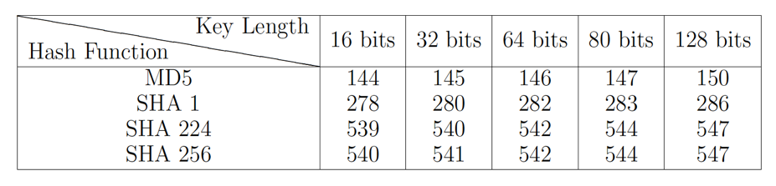
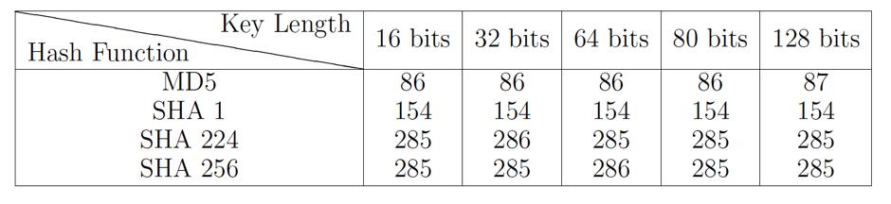
Analysis of results of both HMAC schemes
Regular HMAC
H²MAC

Slide 24
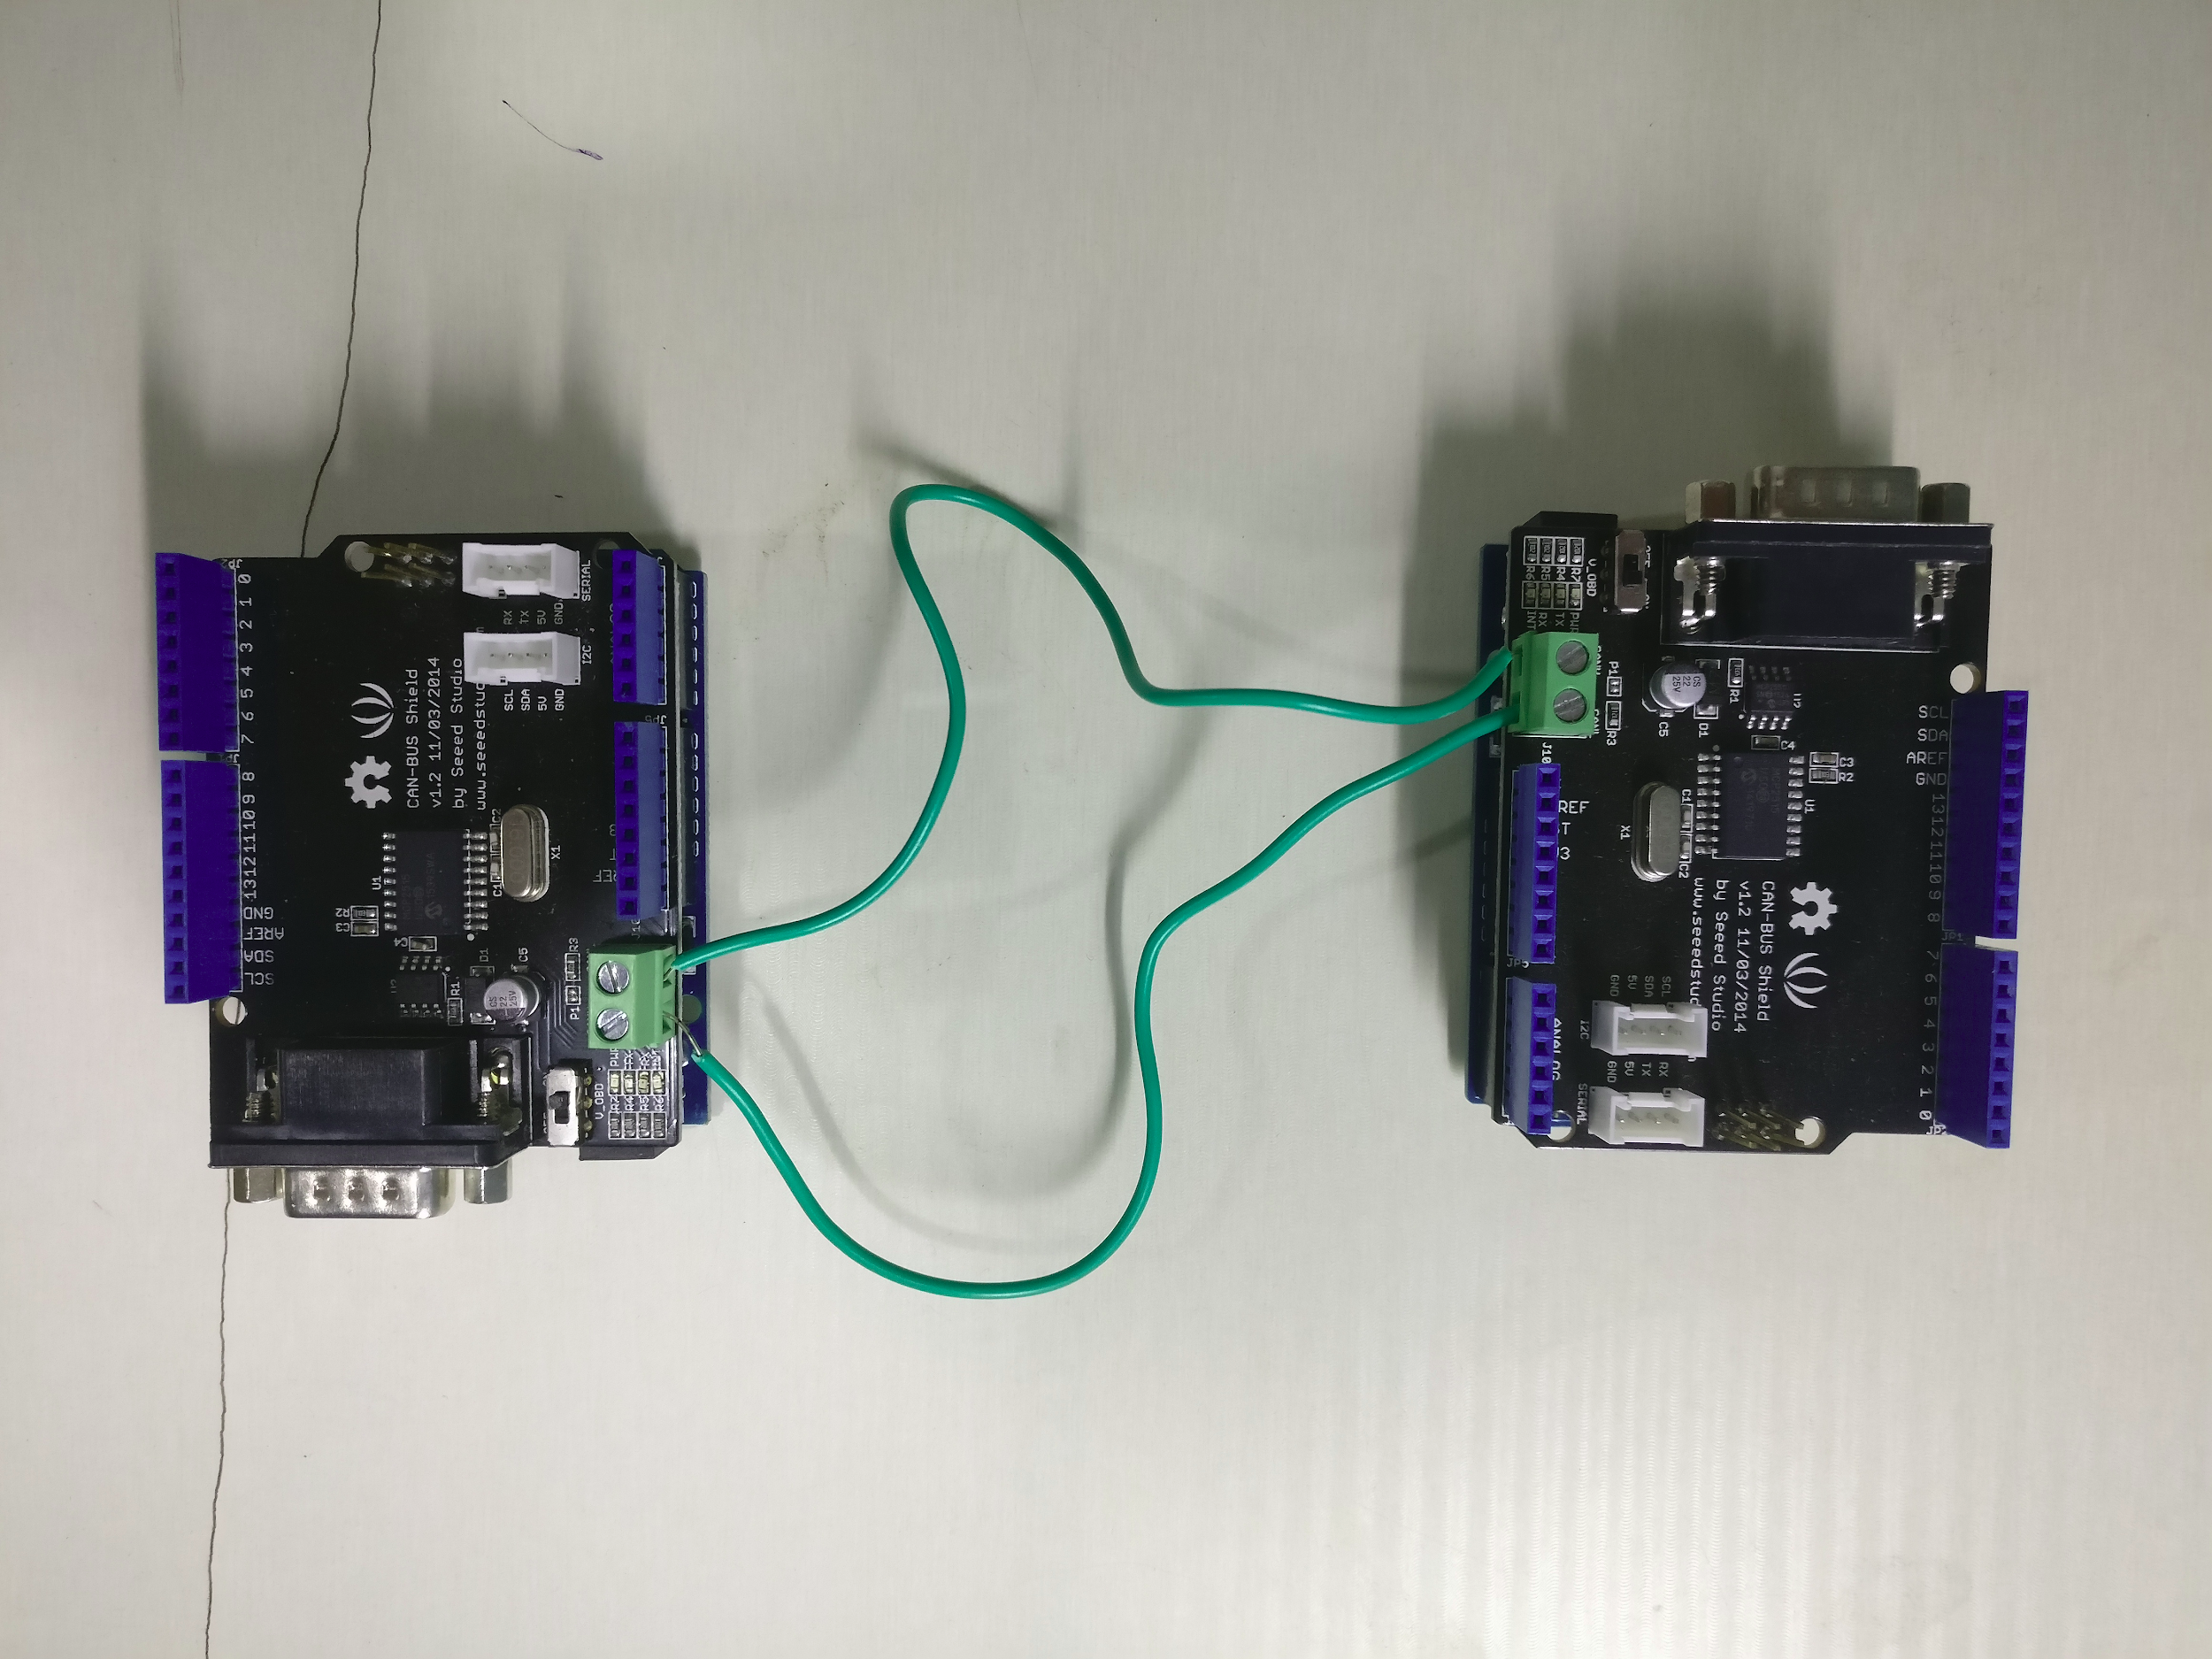
Hardware Employed

Slide 25
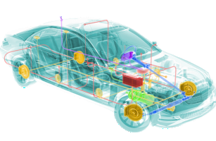
Intrusion Detection System for In-Vehicle Network Security

Slide 26
Synthesizing CAN Bus Anomalies
Random Distribution
Bit-wise Probability Distribution
Byte-wise Probability Distribution
Pairwise Probability Distribution
Pairwise Inverted Probability Distribution

Slide 27
Analysis of Data
Types of Data:
Unchanged Data
Control Data
Continuous Valued Data

Slide 28
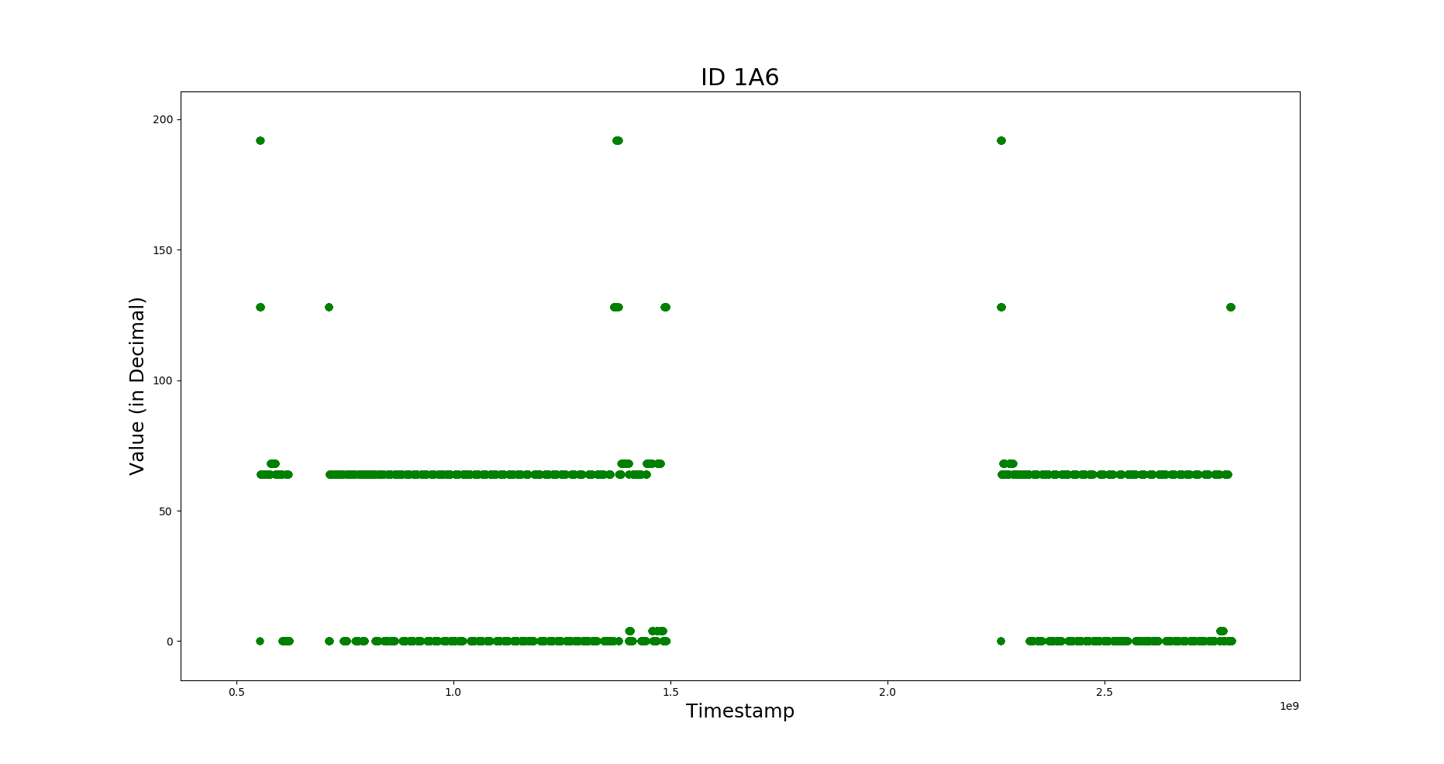
Control Data

Slide 29
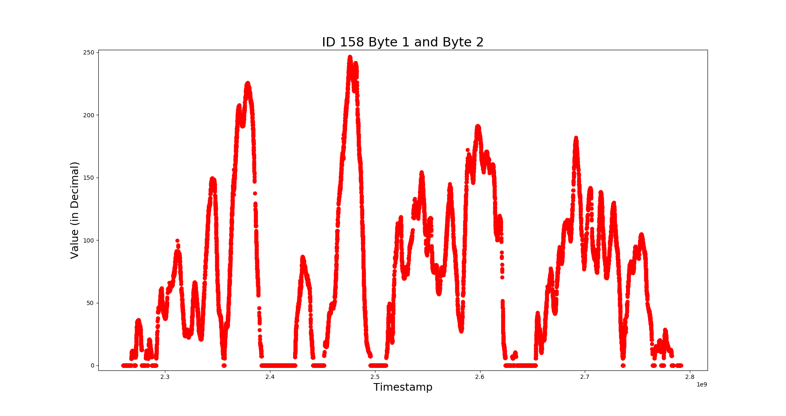
Continuous Valued Data

Slide 30
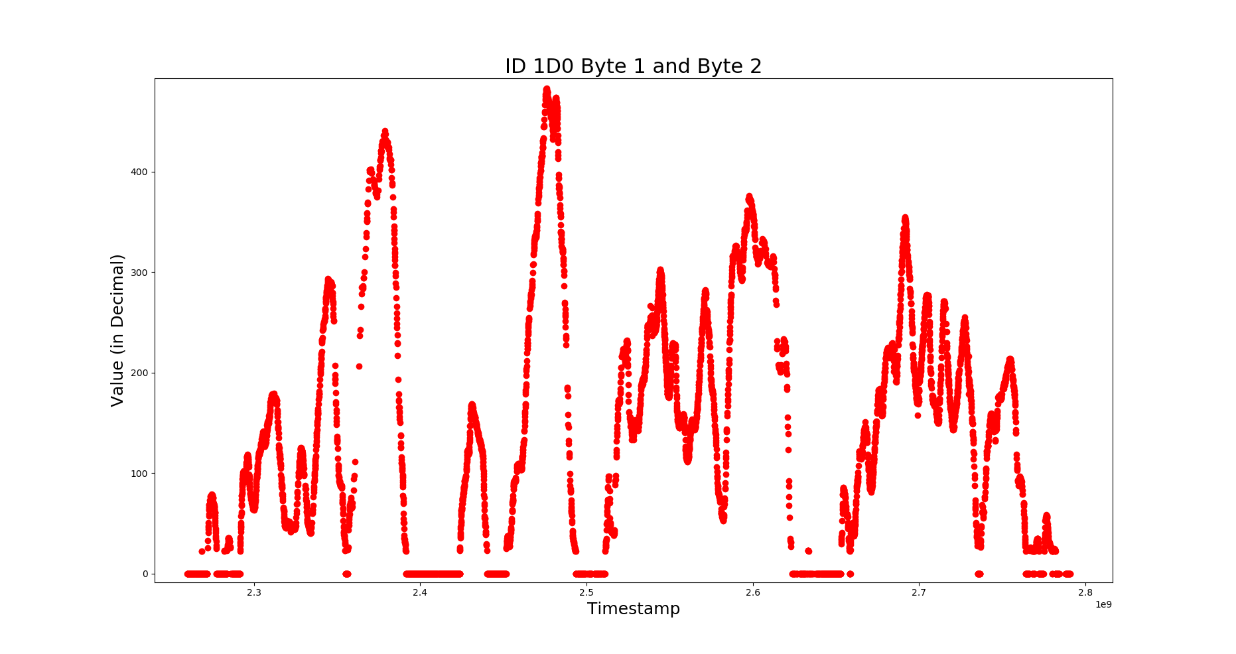
Interrelation Between Data

Slide 31
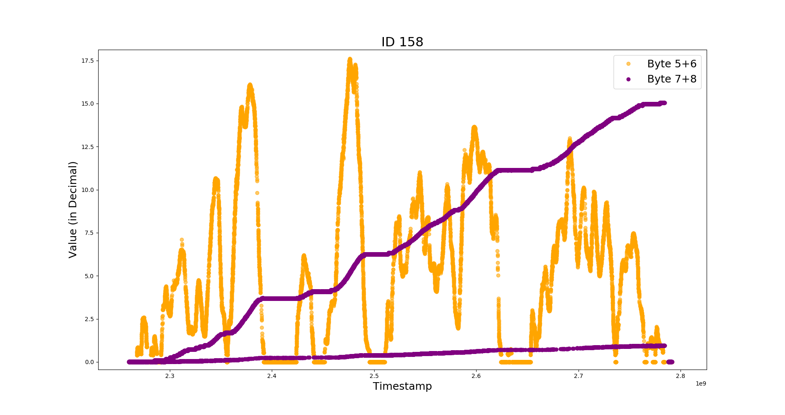

Slide 32
Apriori Data Mining Technique
Association Rules
Support
Confidence
Frequent ItemSets within CAN IDs.

Slide 33
Frequent CAN IDs and its Association
Antecedent | Consequent | Support | Confidence
{158,328,39} | {13C} | 0.0350 | 0.9668508
{17C,1ED,221} | {1A6} | 0.0416 | 0.8421053
{1A4,1A6,295} | {17C} | 0.0576 | 0.8299712
{1ED,221} | {1A6} | 0.0524 | 0.8264984
{158,1AB,1ED,255} | {39} | 0.0868 | 0.7876588
{158,1ED,255} | {39} | 0.1282 | 0.7788578
{221,39} | {1A6} | 0.0442 | 0.7594502

Slide 34
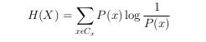
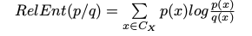
Entropy
Data Abstraction Level
Binary Level
Signal Level
Protocol Level
Information-Theoretic Measures
Relative Entropy:

Slide 35
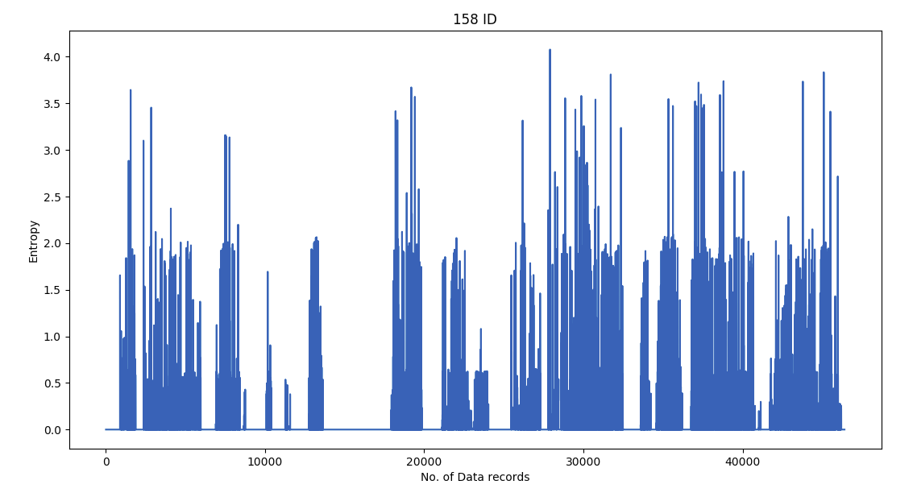
Notes:
Relative Entropy of CAN ID 158 (CAN Message)
Relative entropy for ID 158.
Total no of records: 46407
Average entropy: 0.0973206012162

Slide 36
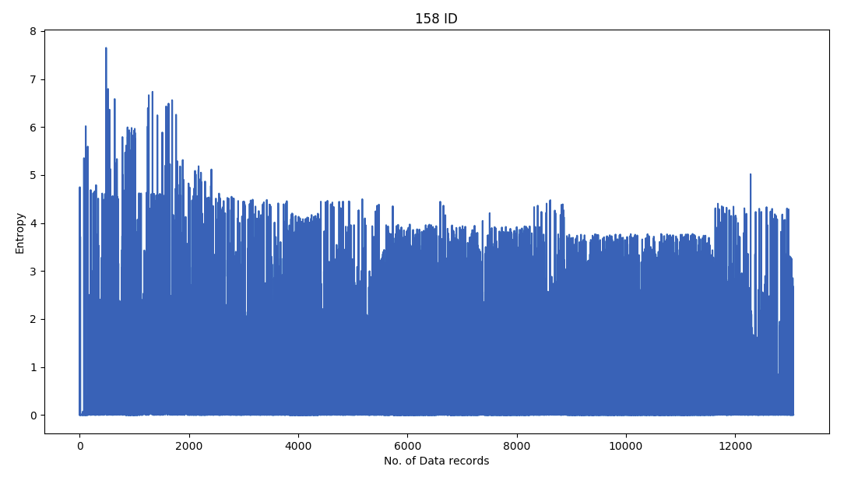
Notes:
Relative Entropy for ID 158 Byte Wise Probability Distribution Anomaly Data Message
Relative Entropy Byte Wise Anomaly Data
Total no of records: 13066
Average entropy:0.788268548194

Slide 37
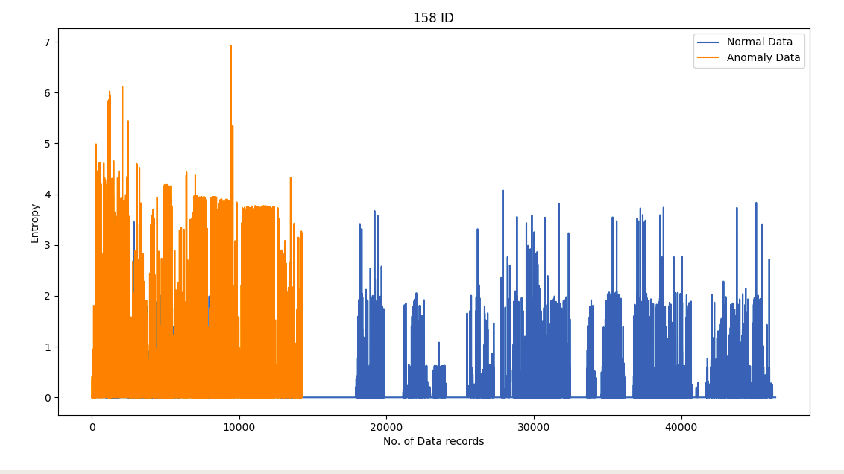
Notes:
Relative Entropy Pair-Wise Inverted Probability Distribution Anomaly along with Normal Data
Relative Entropy for Pair-Wise Inverted Probability Distribution Anomaly and Normal Data for ID 158.
Total no of records: 14232
Average entropy: 0.755837401269

Slide 38
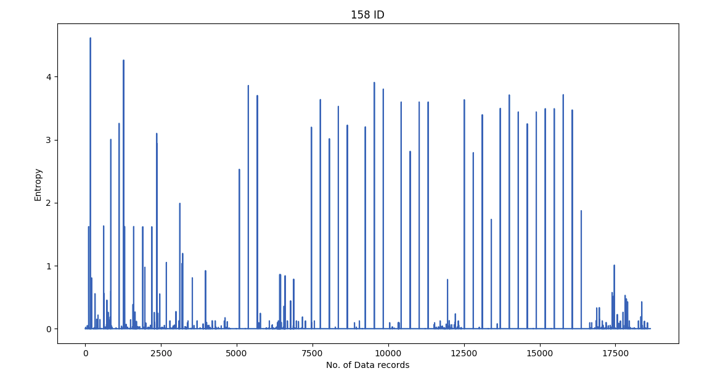
Notes:
Relative Entropy of Anomaly and Normal CAN Data at interval of 100 records

Slide 39
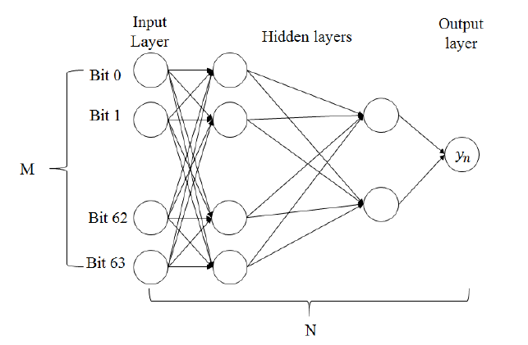
Deep Neural Network
Notes:
Three Hidden Layers : 25,15,5 respective Neurons

Slide 40
Results of DNN
 | Random (Unusual) |  | Probability Distribution |  | Pair Wise Probability Distribution |  | PairWise Inverted Probability Distribution
 | TP | TN | TP | TN | TP | TN | TP | TN
BitWise | 100 | 99.76 | 99.33 | 99.35 | 72.59 | 73.48 | NA | NA
ByteWIse | 99.96 | 98.56 | 99.865 | 95.08 | 90.32 | 81.81 | 83.26 | 91.54

Slide 41
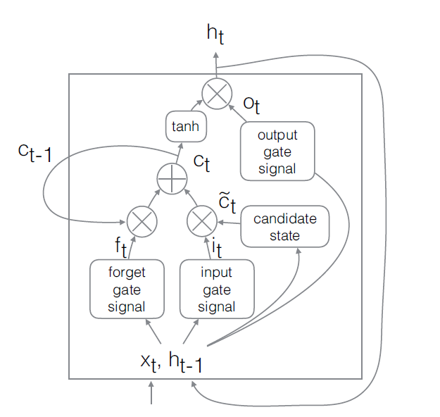
Long Short-Term Memory Networks
Notes:
i_{t} =σ(W_{i}x_{t} + U_{i}h_{t−1} + b_{i})
f_{t} =σ(W_{f}x_{t} + U_{f}h_{t−1} + b_{f} )
c¯t = tanh(W_cx_t + U_ch_t−1 + b_c)
c_t =ft * c(t−1) + ic˜t
ot = α(W_ox_t + U_oh_t−1 + b_o)
h_t = o_t*tanh(c_t)

Slide 42
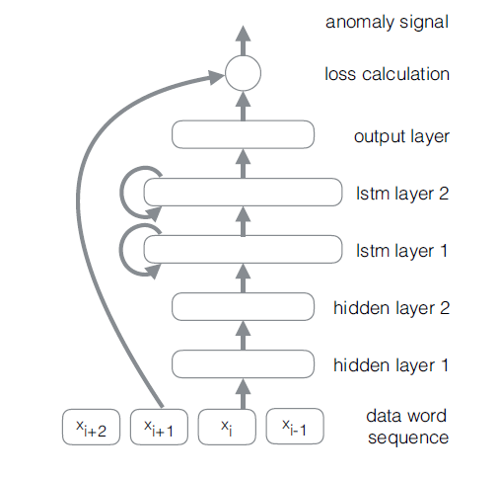
LSTM-based Anomaly Detector Structure
Notes:
. Given an input sequence {x1, x2, x3,...,xN }, where xi is a 64-bit vector, the network is trained for each i with a target of the subsequent word yi = xi+1. At each time step, the input xi is the 64-bit data word from the packet. These bits are transformed by two non-recurrent hidden layers, each with 128 units and tanh activation functions. The output of the linear layers is fed into two recurrent LSTM layers, each with 512 units and tanh activation functions. The final layer is again linear, with 64 units using sigmoid activation functions to scale the final values to between 0 and 1.A separate network was trained for each CAN bus ID.

Slide 43
Results of LSTM
 | Random (Unusual) |  | Probability Distribution |  | Pair Wise Probability Distribution |  | PairWise Inverted Probability Distribution
 | TP | TN | TP | TN | TP | TN | TP | TN
BitWise | 97.86 | 98.41 | 92.47 | 94.84 | 94.34 | 94.29 | NA | NA
ByteWIse | 96.11 | 97.89 | 88.25 | 77.87 | 85.11 | 74.92 | 88.25 | 92.96
Notes:
For byte: 32 32 64 64 8
why bit wise data result is better than byte wise data?
there are more features and pattern in bits rather than bytes.
In pair wise inverted probabilty distribution we didnt consider bitwise data anomaly because the values of extreme max and min were considered in bytes and not in bit.

Slide 44
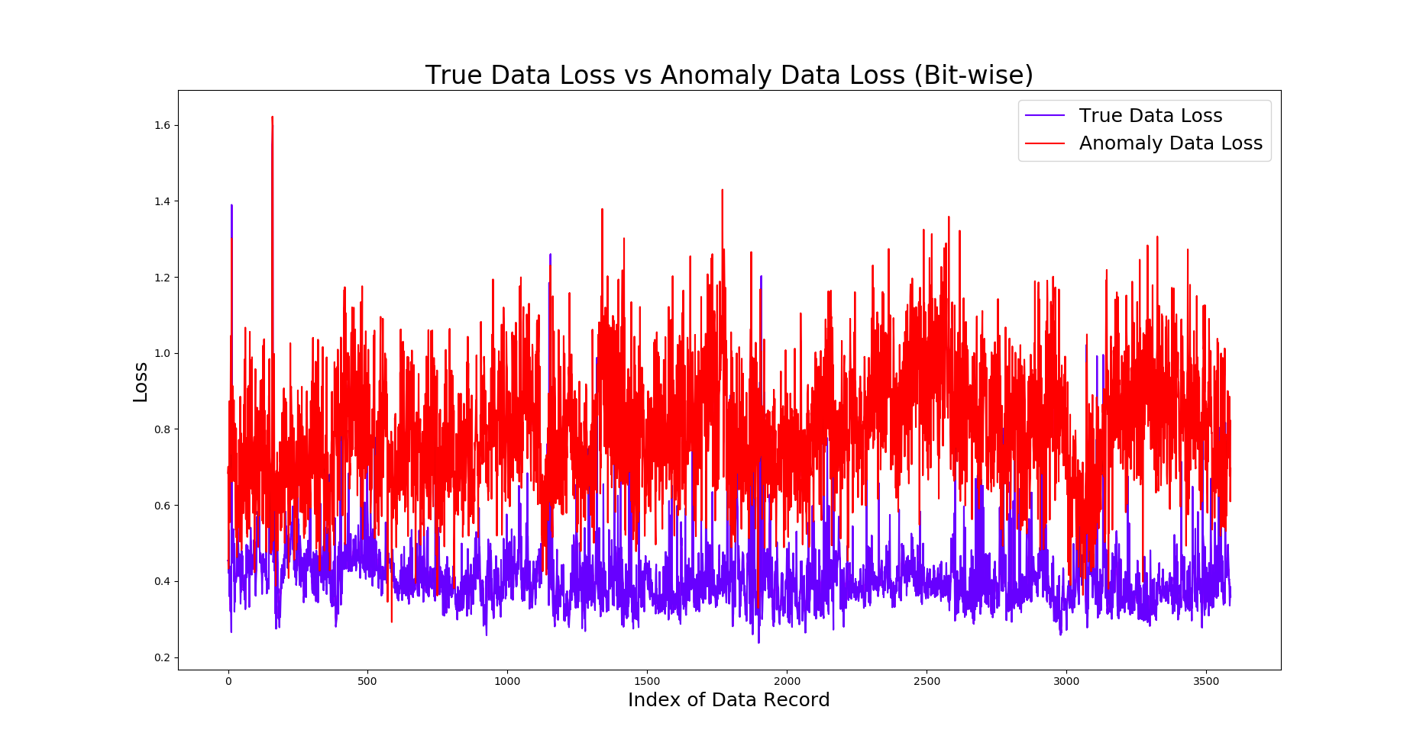
Notes:
Cost function used to evaluate the log loss.
Log loss is less for true data and more for anomaly data because the true data prediction was very near to target data in true data loss and very less in anomaly data loss.
Log loss equation
L(a,b) = b log(a + $) + (1-b) log ( 1 - a + $)

Slide 45
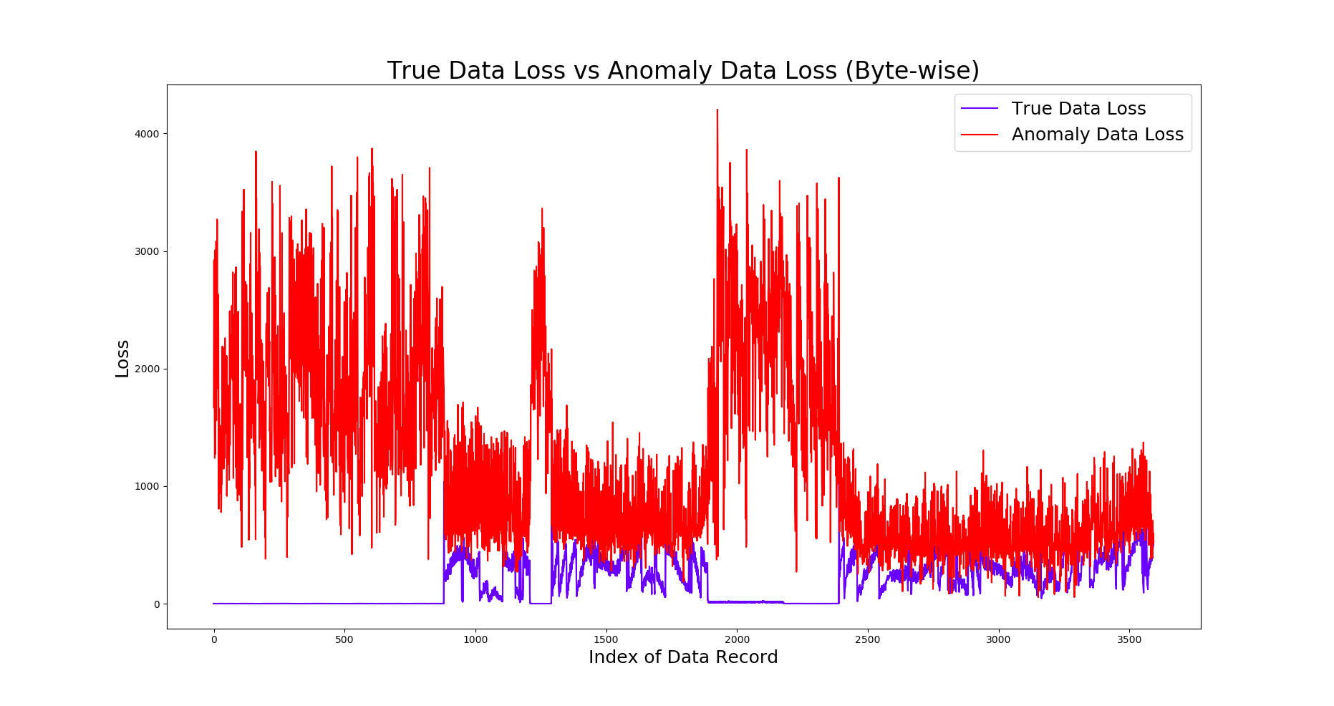
Notes:
Cost function here is binary cross evalution.
Here the graph is showing the similar results as seen in bit wise anomaly data loss. Here the zero loss value condition says that the car was at halt and still relevant CAN data was flowing which is clearly the anomaly data packets and thus the higher loss value.

Slide 46
This project has been completed by
Rushabh Patel (131070005)
Siddhant Shah (131070010)
Abhijit Gupta (131070014)
Mehul Jain (131070051)
under the guidance of
Dr. S. G. Bhirud

